Slide 1
UI Tweening in Unity
Creating Animations for Your Games UI
By Yssie Vargas
Notes:
Hello everyone! Today, I’m going to walk you through UI tweening in Unity. We’ll be focusing on creating smooth UI animations using AnimationCurves, rather than relying on external libraries like LeanTween. By the end of this, you’ll have a solid understanding of how to animate UI elements effectively.

Slide 2
What is UI Tweening?
UI Tweening refers to the short, smooth, animated transitions between UI states.
Instead of instantly changing a UI element’s color, position, size, or transparency, we can use tweening to gradually animate the changes over time.
This improves the Game Feel by allowing the interface to be more dynamic.
Examples of UI tweening in games
https://www.youtube.com/watch?v=9N8oeegbeFM&list=PL1hX1qD7bI72dSwYD1aR8I63zMuuPfLvq
https://www.gameuidatabase.com/uploads/video/Aviary-Attorney11242024-063054-6487.mp4
Notes:
What is UI Tweening?
It refers to smooth, animated transitions between UI states.
Instead of instantly changing UI elements (color, position, size, transparency), we animate them over time.
This makes the UI feel more dynamic and polished, since they are usually the more static aspects of the game
Why use tweening?
It enhances user experience and game feel.
Makes UI interactions more engaging and visually appealing.
Here are some exmaples of cool uses of UI tween that adds to the Game feel. In candy crush, the UI has a cool, bounce/puppet like animation that add to the playful, childlike lightheartedness, the game tries to envoke in its players

Slide 3
What can you do with UI Tweening?
Common Use Cases:
Fading elements (buttons, panels, popups)
Sliding UI components (menus, scoreboards, notifications)
Scaling effects (buttons pulsing, UI shrinking and expanding)
Complex motion (smooth custom animations using keyframes)
Notes:
Tweening can be used for:Fading elements (making buttons appear/disappear smoothly).
Sliding UI components (e.g., menus or notifications).
Scaling effects (making a button pulse when clicked).
Complex motion (custom animations with keyframes).
This tutorial will focus on these core types of tweening.

Slide 4
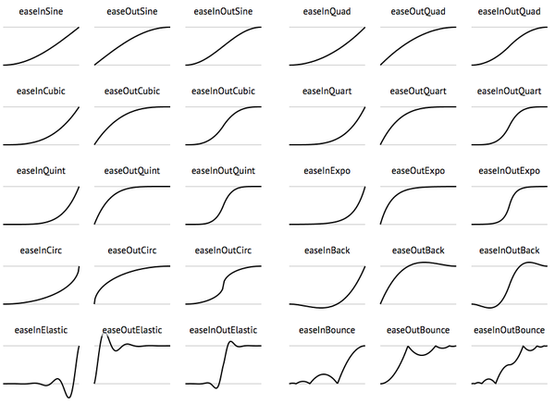
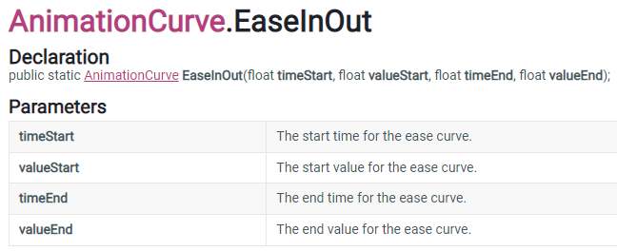
Animation Curve Easing
Note that a lot of tweening can be done with just Unity, without referring to any Library Packages.
What is easing?
Easing controls the speed of the animation, like starting slow and speeding up, to mimic the dynamic movement of reality.
When a car stops and goes, it will slow down gradually and then pick up speed again after stopping.
Instead of moving linearly, easing makes motion feel more natural.
AnimationCurve is a Unity default type that can be used for tweening.
See examples of these curves,
how they effect motion,
and grab the math:
https://easings.net/
AnimationCurve.EaseInOut(0f, 0f, 1f, 1f);
Notes:
What is easing? Easing controls the speed of an animation over time.
Why does it matter? It makes animations feel natural, mimicking physics (e.g., acceleration and deceleration).
Instead of moving at a constant speed, easing lets us ramp up and slow down for a smooth effect.
Unity’s AnimationCurve lets us define these custom transitions.
Code Snippet Example Explanation:
We use AnimationCurve.EaseInOut(0f, 0f, 1f, 1f); to create a natural start/stop motion.
This is used in the fade-in effect for the start button.

Slide 5
Animation Curve Easing
Notes:
This video demonstrates why easing can be so important in changing the feeling of the game. By having dynamic UI, the game becomes more engaging and can provide valuable player feedback.

Slide 6
Custom Key Frame Easing
Why Use Keyframe-Based Motion?
Instead of predefined easing curves, we can manually define motion behavior.
Useful for creating unique, non-standard animations that feel more organic.
Lets us control speed, acceleration, and overshoot with precision.
private AnimationCurve slideEase = new AnimationCurve(
new Keyframe(0f, 0f, 0f, 3f), // Starts slow
new Keyframe(0.3f, 0.5f, 2f, 2f), // Gains some speed
new Keyframe(0.6f, 1.3f, 3f, -3f), // Overshoots further for more bounce
new Keyframe(0.8f, 0.9f, -2f, -2f), // Corrects back towards final position
new Keyframe(1f, 1f, -1f, 0f) // Settles in final position
);
Notes:
Code Breakdown:
The first keyframe starts the motion slow.
The second keyframe increases speed and overshoots.
The final keyframe settles into position.

Slide 7
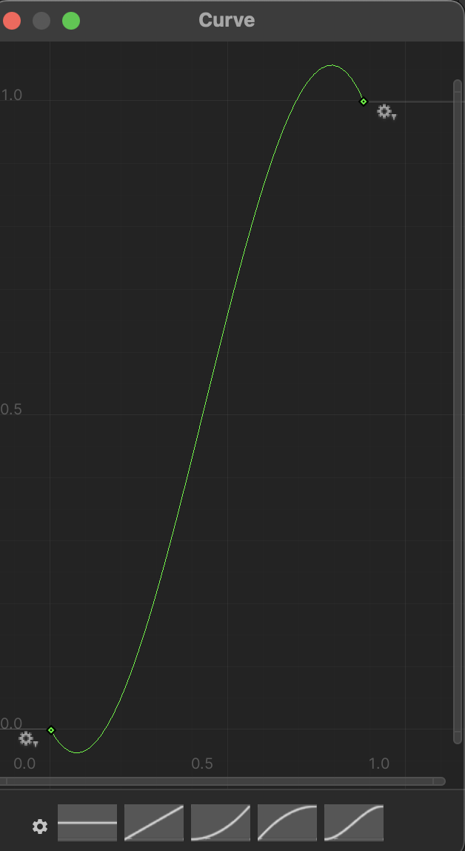
Public Animation Curves
Like other unity objects, you can make a public animation curve that can be modified in the inspector.
Why Use Public Animation Curves?
Instead of hardcoding easing, we expose curves in the Unity Inspector.
This allows designers to tweak motion without modifying code.
public AnimationCurve pulseEase; // Set this in Unity
private float pulseProgress = 0f;
void Update()
{
pulseProgress += Time.deltaTime * 2f;
float scale = pulseEase.Evaluate(pulseProgress); button.transform.localScale = Vector3.one * scale;
}
Notes:
Slide: Public Animation Curves
Instead of hardcoding easing into the script, we can expose it in Unity’s Inspector.
Why is this useful? Designers can tweak the animation without modifying code.
Code Example:
pulseEase.Evaluate(pulseProgress); reads the curve value at different times.
This lets us create a pulsing button effect.
The pulsing effect allows for responsive player feedback and

Slide 8
Tweening with Libraries (LeanTween)
Instead of manually coding an animation with animation curves or easing, you can use Unity Libraries like LeanTween to simplify the code.
Why Use LeanTween?
Lightweight and efficient animation library for Unity.
It simplifies animations with fewer lines of code compared to manually controlling animation states.
Allows for easy chaining of animations with setOnComplete().
Supports a variety of easing functions (easeInOutQuad, easeOutBounce, etc.).
Non-blocking: doesn't require Update() to manage animations
LeanTween.alphaCanvas(startButton.GetComponent<CanvasGroup>(), 1f, 0.5f).setEase(LeanTweenType.easeInOutQuad);
LeanTween.moveY(startButton, 0, 1f).setEase(LeanTweenType.easeOutBounce);
The first line fades in the button using alphaCanvas(), which modifies the alpha of a CanvasGroup attached to the button.
The second line moves the button’s Y position smoothly over 1 second using easeOutBounce.

Slide 9
Recap!
Why UI Tweening is Important
Makes UI feel more dynamic and responsive.
Improves user experience by grabbing and guiding their attention naturally.
Used in professional applications, games, and interactive media.
Helps maintain a clean and modern interface.
What We’ve Covered So Far
Different types of UI animations: fading, sliding, pulsing, and scaling.
Using Animation Curves for custom movement.
How LeanTween simplifies UI animation.
Best practices for smooth and efficient UI transitions.

Slide 10
Next up: Demo ->
How YOU can implement simple UI tweening in your game!!

Slide 11
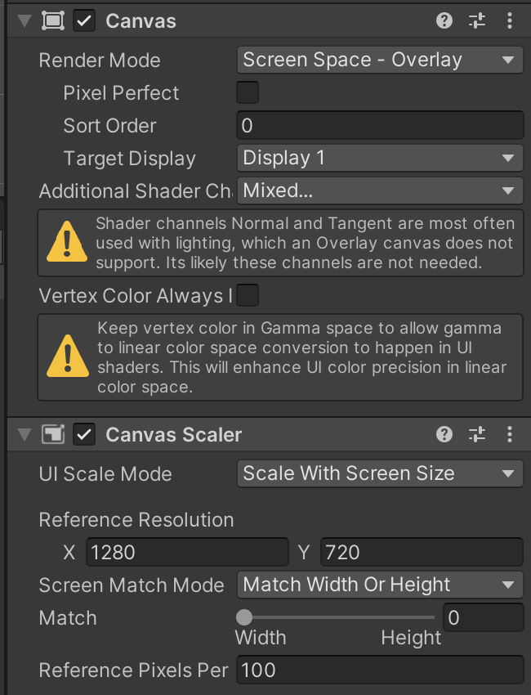
Setting up the project
Open Unity
Go into Tutorial 1 and import the Given UITweening Package.
Create a Canvas:
In the Hierarchy, right-click and select UI > Canvas.
The Canvas should have the following settings:
Render Mode: Set to Screen Space - Overlay.
Canvas Scaler: Set to Scale With Screen Size.
Set the Reference Resolution to 1280 x 720
If desired, change the background color of the Canvas by changing the color settings.
Notes:
Steps to create the project:
Open Unity, create a new 2D project and name it UI Tween Demo.
Add a Canvas: Right-click Hierarchy → UI → Canvas.
Set Canvas properties:
Render Mode: Screen Space - Overlay
Canvas Scaler: Scale With Screen Size
Reference Resolution: 1280 x 720
Change the background color if desired.

Slide 12
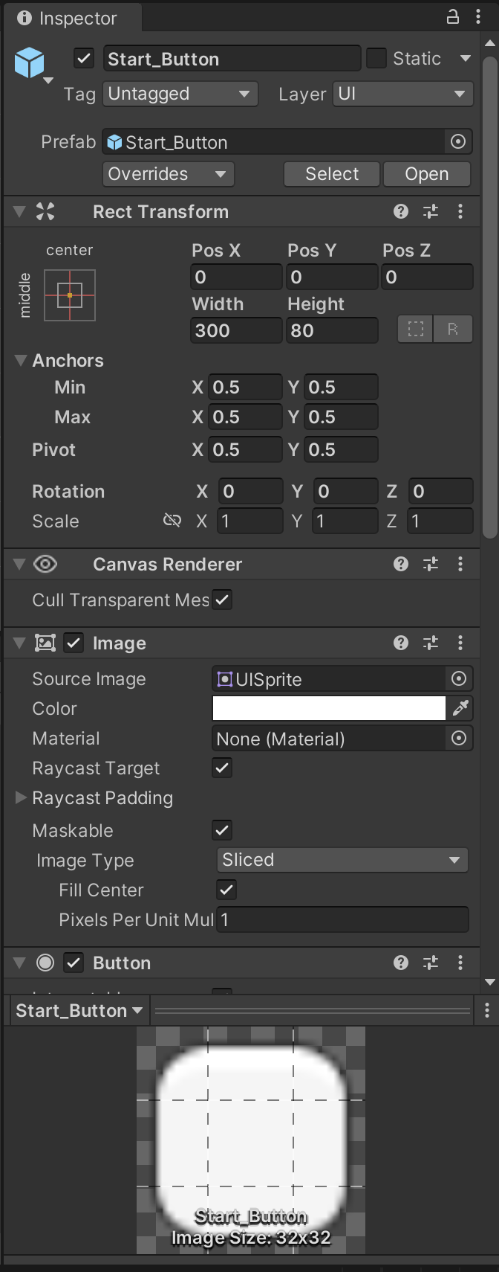
Basic UI Animation (Animation Curve Ease In)
Create the Start Button:
In the Hierarchy, right-click and select UI > Button, and name it Start_Button
Reset Transformations and Adjust the width = 300 and the height = 80 .
Center the button in the middle of the canvas.
Create a new Empty GameObject in the scene and name it UIManager.
Reset the transformations and Attach given UIMangaer Script to the game object
In the UIManager script, uncomment the code on the next slide to make the Start Button fade in when the game starts.
In the Inspector for the UIManager, drag the StartButton G.O. from the Hierarchy into the Start Button field.
Notes:
In this section, we’ll animate the fade-in effect for a UI button.
The goal is to make the button start invisible and then gradually become visible when the game begins.
This creates a smooth UI transition instead of a sudden appearance.

Slide 13
Code for Fade Animation (UNCOMMENT)
UNCOMMENT FROM STARTER CODE
void Start()
{
startButtonRect = startButton.GetComponent<RectTransform>();
startButton.GetComponent<Image>().color = new Color(1, 1, 1, 0);
startButtonRect.localScale = Vector3.one * 0.8f;
isFading = true;
startButtonRect.anchoredPosition = new Vector2(0, 0);
}
void Update()
{
if (isFading){
fadeProgress += Time.deltaTime * 1f;
float alpha = fadeEase.Evaluate(fadeProgress);
startButton.GetComponent<Image>().color = new Color(1, 1, 1, alpha);
if (fadeProgress >= 1f) isFading = false;
}
}
Notes:
Get the button's RectTransform to control size and position.
Set the initial transparency to 0 so it's completely invisible.
Scale the button down to 80% of its size to make it look more dynamic.
Enable a boolean flag (isFading) to start the fade animation.
The Update() method runs every frame, making the fade effect gradual.fade
Progress increases over time, controlling the animation speed.
Use an animation curve for smooth fading instead of a boring linear effect.
Apply the alpha value to the button, making it more visible each frame.
Once the fade is complete, turn off the fading flag to stop unnecessary updates.
A linear fade would feel robotic and unnatural.
The ease-in-out curve makes it start slow, speed up, and then slow down again, creating a natural effect.
This technique is used in professional UI animations for a polished look.

Slide 14
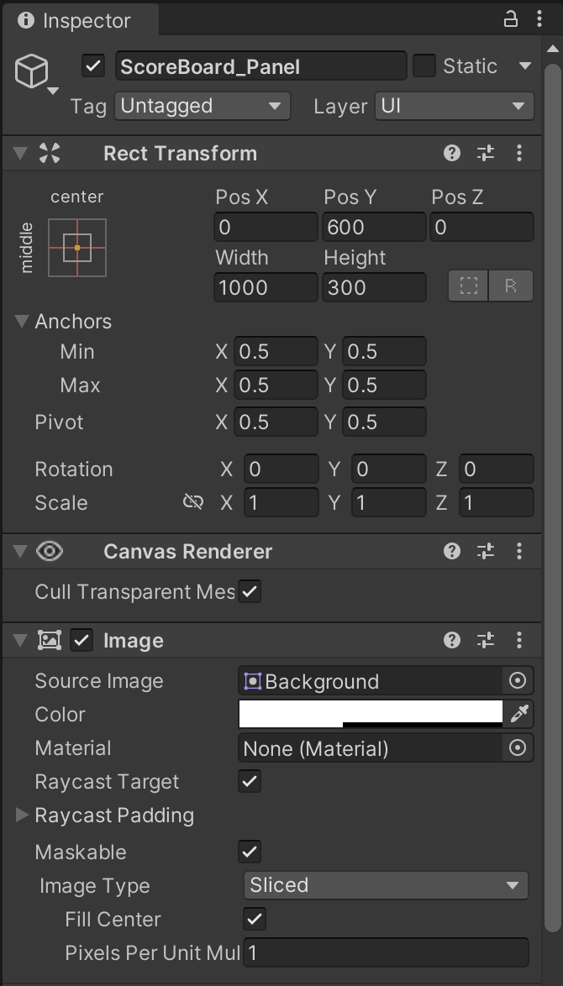
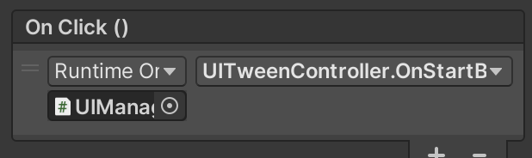
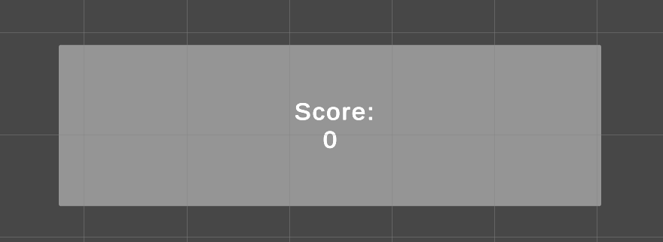
Moving UI Elements (Custom Ease)
Create the Scoreboard Panel:
In the Hierarchy, right-click and select UI > Panel, and name it ScoreboardPanel.
Adjust the size of the panel to be smaller than the screen ( Width = 1000, Height = 300).
Change the Color to make it visible (light gray or blue).
Add the Score Text:
Right-click on the ScoreboardPanel in the Hierarchy and select UI > Text – TextMeshPro, name it ScoreText.
Adjust the TextBox to be centered inside the panel, with Width = 200 and Height = 100.
Change the text to say "Score: 0" (this will be updated during the game).
3. Slide the Scoreboard Panel into View:
In the UIManager script, write the code on the next slide to make ScoreBoard slide in when the button is pressed.
4. Link to start button
Drag UIManager Game Object to the OnClick() Gameobject field and change it to OnStartButtonPressed()
Drag the ScoreboardPanel and ScoreText into designated fields in the UIManager Inspector
Notes:
The scorePanel is positioned off-screen (0,600), ready for an animated slide-in later.

Slide 15
Code for sliding
ADD HIGHLIGHTED LINES TO START
void Start()
{
startButtonRect = startButton.GetComponent<RectTransform>();
scorePanelRect = scorePanel.GetComponent<RectTransform>();
startButton.GetComponent<Image>().color = new Color(1, 1, 1, 0);
startButtonRect.localScale = Vector3.one * 0.8f;
isFading = true;
startButtonRect.anchoredPosition = new Vector2(0, 0);
scorePanelRect.anchoredPosition = new Vector2(0, 600);
}
UNCOMMENT PUBLIC GAME OBJECT DECLARATIONS
public GameObject scorePanel;
public TextMeshProUGUI scoreText;
private int score = 0;
Notes:
We store the panel’s RectTransform so we can move it using an animation.
The panel starts off-screen (e.g., scorePanelRect.anchoredPosition = new Vector2(0, 600);).
When triggered, it moves down to its final position smoothly.

Slide 16
Code for sliding pt2
IN UPDATE:
if (isSliding)
{
slideProgress += Time.deltaTime * 1.5f;
scorePanelRect.anchoredPosition = Vector2.LerpUnclamped(new Vector2(0, 600), new Vector2(0, 0), customSlideEase.Evaluate(slideProgress));
if (slideProgress >= 1f) isSliding = false;
}
UNDER START() AND UPDATE():
public void OnStartButtonPressed()
{
isSliding = true;
startButtonRect.anchoredPosition = new Vector2(0, -600);
}
Notes:
Why not just use Lerp()?Lerp() moves from A to B in a straight, linear way (boring and robotic).
LerpUnclamped + Animation Curve lets us create a non-linear motion path.
The UI element can overshoot slightly and bounce into place, which feels more dynamic.
CUSTOM ease
Keyframes Breakdown:(0f, 0f, 0f, 3f): Starts still (0f, 0f), then accelerates quickly (tangent = 3).
(0.6f, 1.2f, 3f, -3f): Overshoots past the final position, adding a bounce effect.
(1f, 1f, -3f, 0f): Eases back into place smoothly.
Without a custom curve, the UI panel would slide mechanically into place.The bounce effect makes it feel more fluid and natural, similar to modern mobile app UI transitions.Real-world example:Sliding menus in iOS and Android apps often overshoot slightly before settling.

Slide 17
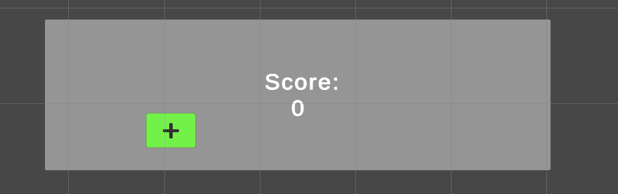
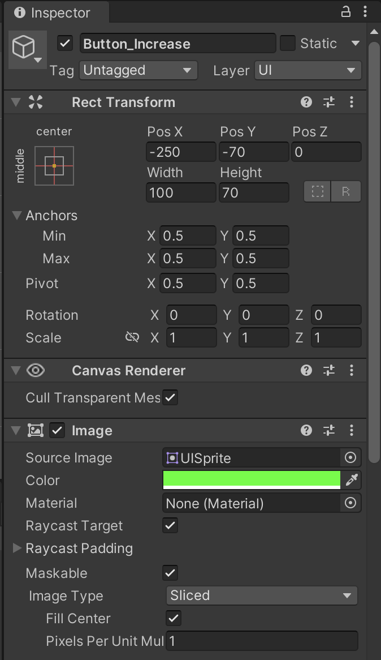
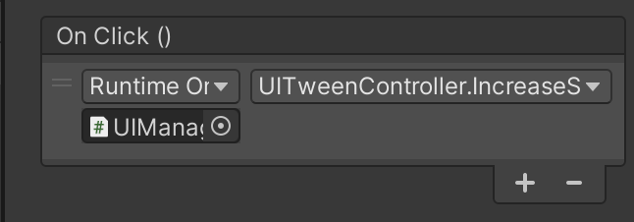
Pulse Animation (public curve)
1. Create the Increase Button:
Right-click on the ScoreboardPanel and select UI > Button and name it Button_Increase.
Adjust the size and color of the button to visually represent adding points.
Change the text of the button to +.
2. Add the Increase Function in UIManager:
In the UIManager script, uncomment the code from on the next slide.
3. Link the Button to the Increase Function:
In the Inspector for the Button_Increase, scroll down to the OnClick() section.
Add the UIManager GameObject to the OnClick() field and select the IncreaseScore() function.
Adjust the pulsing curve in the UIManager Inspector
1. Select the S curve and adjust as needed to create the bounce effect
Notes:
Makes an object grow and shrink to draw user attention.
Often used for score pop-ups, notifications, or important UI elements.
Starts slow, speeds up, and then slows down before repeating.
What the Curve Represents
The X-axis (horizontal) represents time (0.0 to 1.0, or start to finish of the animation).
The Y-axis (vertical) represents the progress of the animation (0 = starting point, 1 = final position).
The shape of the curve determines the speed and motion style of the animation.
2.
Key Characteristics of This S-Curve
Ease-In (Slow Start)
The curve starts flat near (0,0), meaning the motion begins very slowly.
Dips below x axis to replicate movement anticipation
Before jumping, a character crouches down slightly before pushing off the ground.
This creates a natural acceleration effect, making the movement feel organic rather than robotic.
Example in UI: A panel sliding onto the screen doesn’t instantly move; instead, it begins gently.
Steep Middle Section (Fast Movement)
The steepest part of the curve means the object accelerates quickly.
This is where most of the movement happens in a short amount of time.
This fast transition prevents animations from feeling sluggish or unresponsive.
Overshoot Effect
The curve goes above 1.0 before settling back down.
This means the object moves slightly past its target, then corrects itself.
This adds a bounce-back effect or a sense of elasticity.
Example: A button press that shrinks too much before snapping back to its original size.
Ease-Out (Smooth Stop)
The curve flattens out towards the end.
The motion slows down before stopping rather than stopping abruptly.
This makes the animation feel natural and polished rather than mechanical.

Slide 18
Code for Increase Score
IN UPDATE():
if (isPulsing){
pulseProgress += Time.deltaTime * 2f;
float scale = pulseEase.Evaluate(pulseProgress);
scorePanel.transform.localScale = Vector3.one * scale;
if (pulseProgress >= 1f) isPulsing = false;
}
UNDER UPDATE()
public void IncreaseScore()
{
score++;
scoreText.text = "Score: " + score;
pulseProgress = 0f;
isPulsing = true;
}

Slide 19
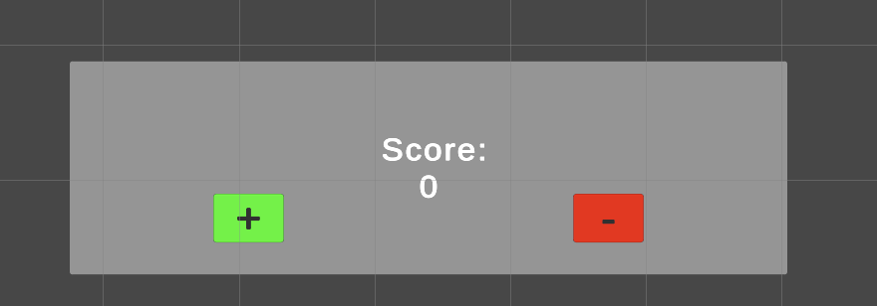
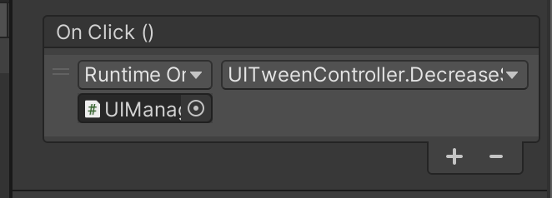
Shrink Animation With Lean tween
Create the Decrease Button:
Inside the Scoreboard Panel, right-click and select UI > Button.
Name the button Button_Decrease.
Adjust the size and color to visually represent subtracting points.
Change the button text to -
Modify the UIManager Script:
In the UIManager script, add the code from on the next slide to handle the animation
Link the Button to the Function:
In the Inspector for the Button_Decrease, scroll down to the OnClick() section.
Add the UIManager GameObject to the OnClick() field.
In the dropdown, select the DecreaseScore() function.
Notes:
First shrink:
Scales the object to 0.9f of its original size in 0.2s (LeanTween.scale()).
Uses easeInOutQuad to create a natural acceleration/deceleration.
After the shrink, it scales back to normal (1.0f).
The setOnComplete() ensures that the second animation only starts after the first finishes.
Why Use LeanTween
Optimized for UI animations.
Handles tweens smoothly without needing Update().
Better than Coroutines for UI-based transitions.

Slide 20
Code for Decrease Score
public void DecreaseScore()
{
score--;
scoreText.text = "Score: " + score;
LeanTween.scale(scorePanel, Vector3.one * 0.9f, 0.2f).setEase(LeanTweenType.easeInOutQuad)
.setOnComplete(() => LeanTween.scale(scorePanel, Vector3.one, 0.2f).setEase(LeanTweenType.easeInOutQuad));
}

Slide 21
All together
The Tweening shown in this presentation only shows some of the many tricks that can be done with tweening. I encourage you to play around with what you have now by changing some of the time variables, pixel arguments and animation curves given with ease-in or ease-out.
Now you have a small interface that demonstrates simple UI tweening that can be added to improve the Game Feel of your project!
Notes:
. Why UI Tweening Matters
UI should feel alive and responsive.
Simple scale, fade, and slide effects add polish to the user experience.
Used in all modern apps & games to make interactions feel smooth.
2. Choosing the Right Animation for the Right Context
Fade-in → Great for introducing UI elements smoothly.
Slide-in → Works best for menus, notifications, or panels.
Pulsing → Helps highlight important UI elements.
Shrink on click → Makes buttons feel more tactile.
3. Why We Use LeanTween
Performance optimized for UI animations.
No need for custom Update() logic.
More control over easing, delays, and sequences.

